Slide 1
Implementing an Acuity Scale for Staffing in the Inpatient Setting: An Evidence-Based Practice Project
By: Kristen Brunelle, Carmin Erickson, and Sarah Fulton
Notes:
Final presentation is August 4th @ 2 pm MDT
With members of executive leadership including the interim president and the interim vice president, the unit directors and the unit charge nurses.

Slide 2


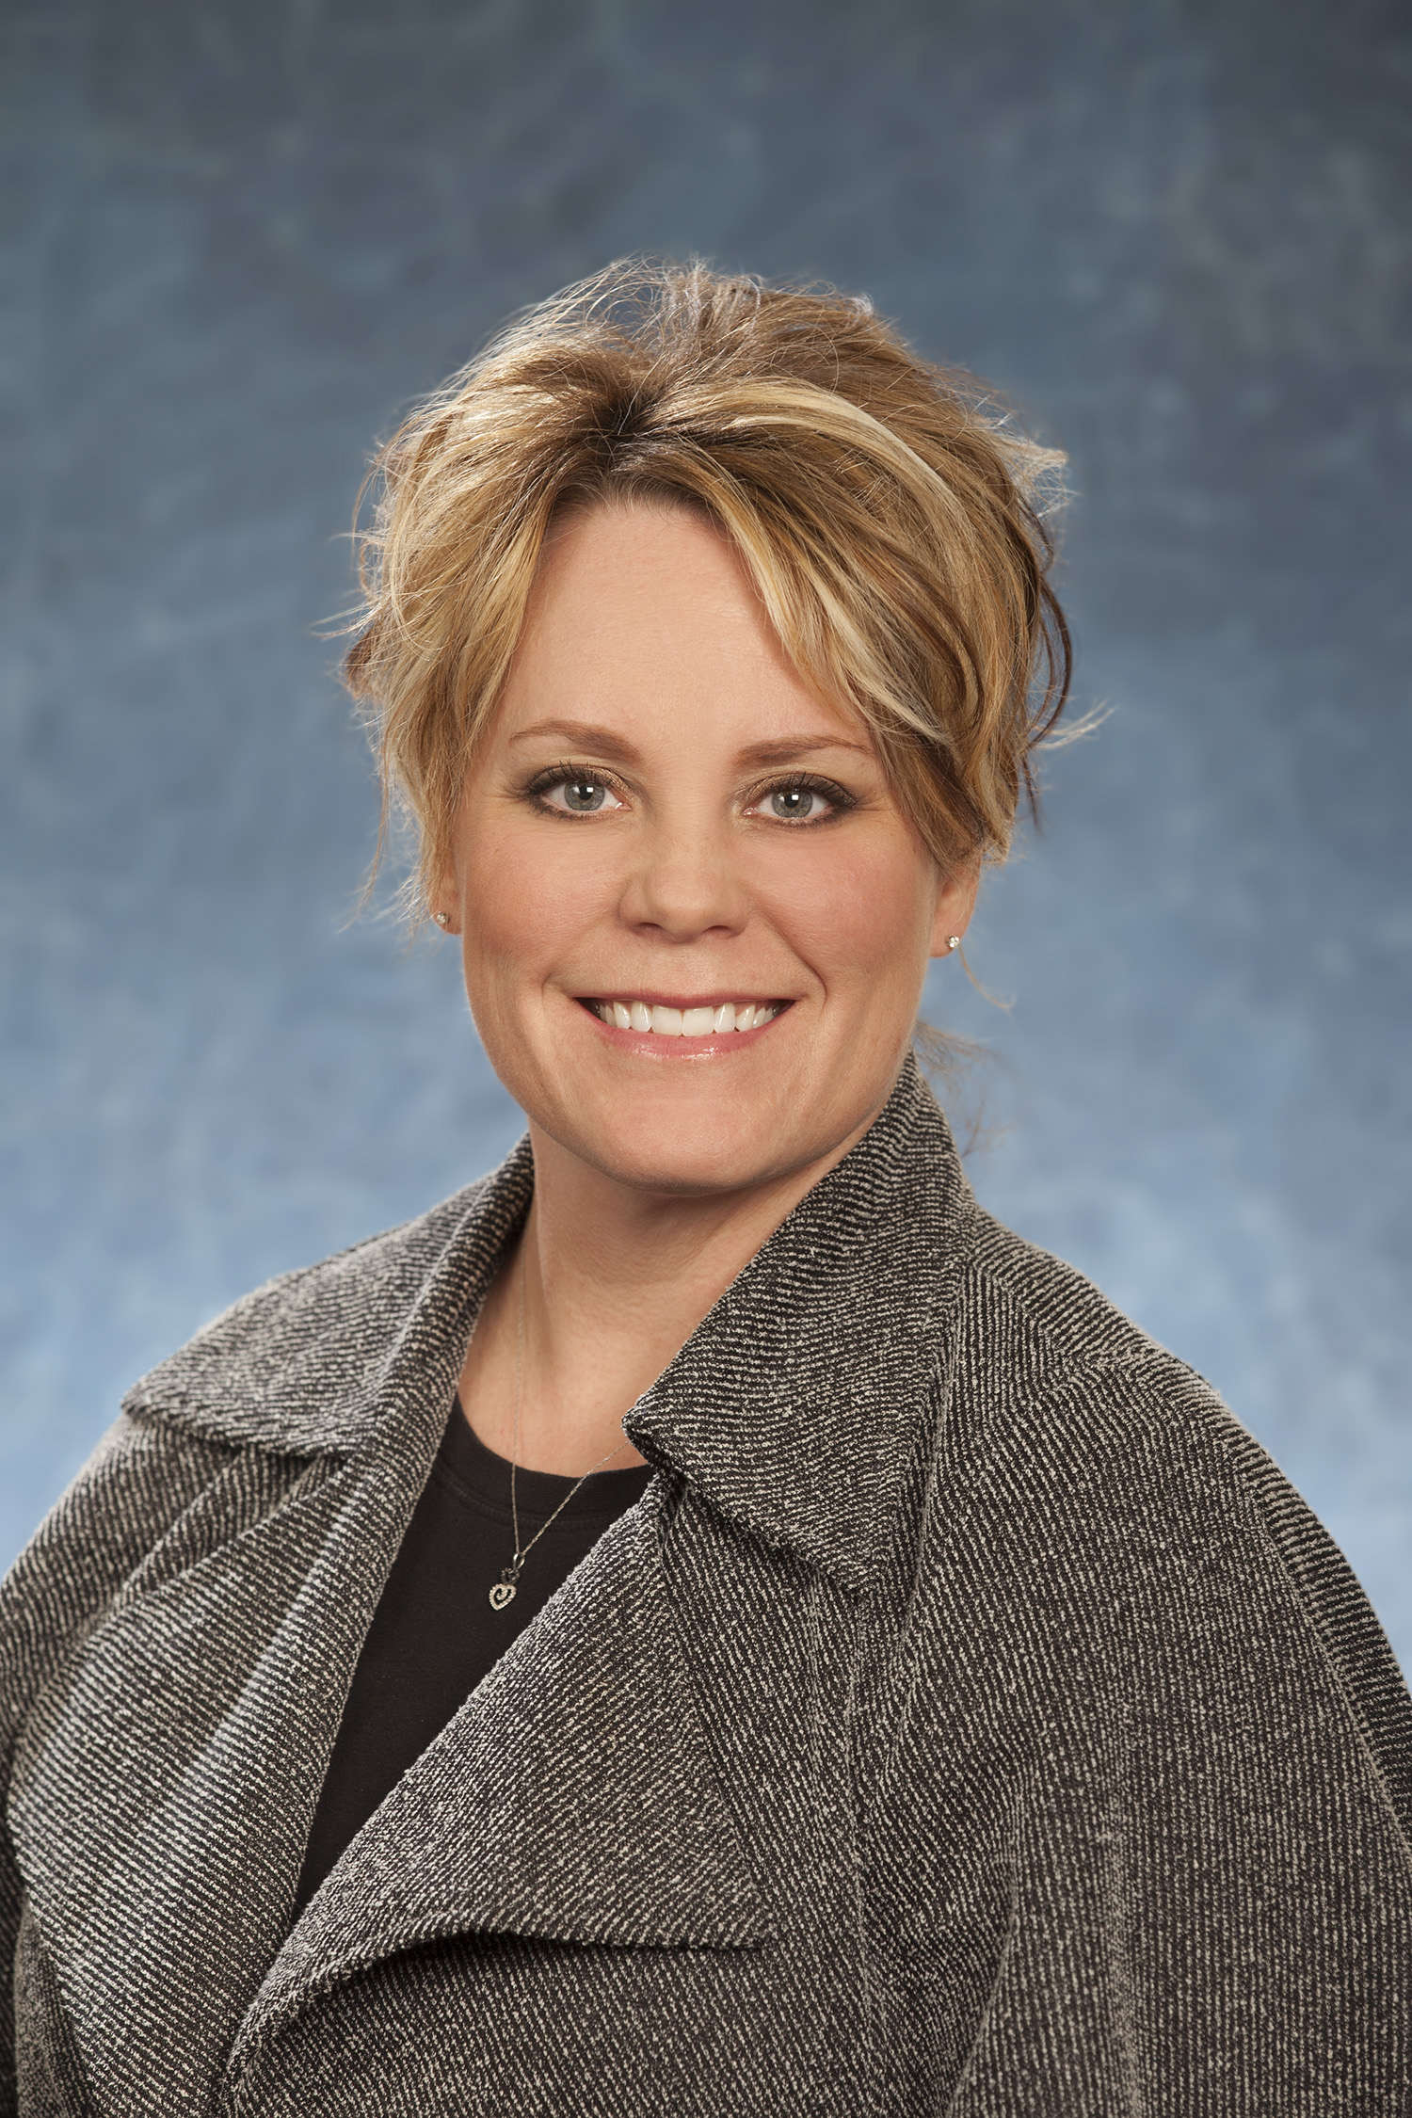

Meet your UMary Graduate Team
Kristen Brunelle BSN, RN
Health Care Administration Dual Degree Program MSN & MBA
Carmin Erickson, BSN, RN
Nursing Leadership and Management
MSN
Sarah Fulton, BSN, RN
Health Care Administration
Dual Degree Program
MSN & MBA

Slide 3
Thank you
University of Mary Student Team
Our project advisor Claudia Dietrich
CHI St. Alexius Health Dickinson Medical Center Leadership
  DeeAnna Opstedahl, CEO
CHI St. Alexius Nursing Staff
Family and Friends
Notes:
This project also would not have been completed without the large support CHI St. Alexius Health Dickinson Medical Center in Dickinson ND. CHI allowed us to bring our project to life by collaborating and opening their organization to our project..
Vice President of Patient Care Services and Interim CEO DeeAnna Opstedahl, as she more than willingly volunteered to be an organizational and leadership mentor and help develop this project idea.

Slide 4

Hospital Demographic
  Rooms 1-7 Inpatient (OB)
  Rooms 8-21 Inpatient (MSP)
  Room 22-25 Inpatient (ICU)
  Room 26-28 (OBV MSP)
  Rooms 29-32 (Labor rooms)
  Rooms 33-34 (OBV overflow in ED)
Retrieved from: https://wexnermedical.osu.edu/blog/patients-value-control-privacy-in-hospital-rooms
Notes:
CHI St. Alexius Health Dickinson is a 25 bed, critical access facility employing 150 nurses in SW North Dakota. The focus of the project is the medical/surgical unit comprised of 30 nurses. (Feedback was to include more info on background of organization?)

Slide 5
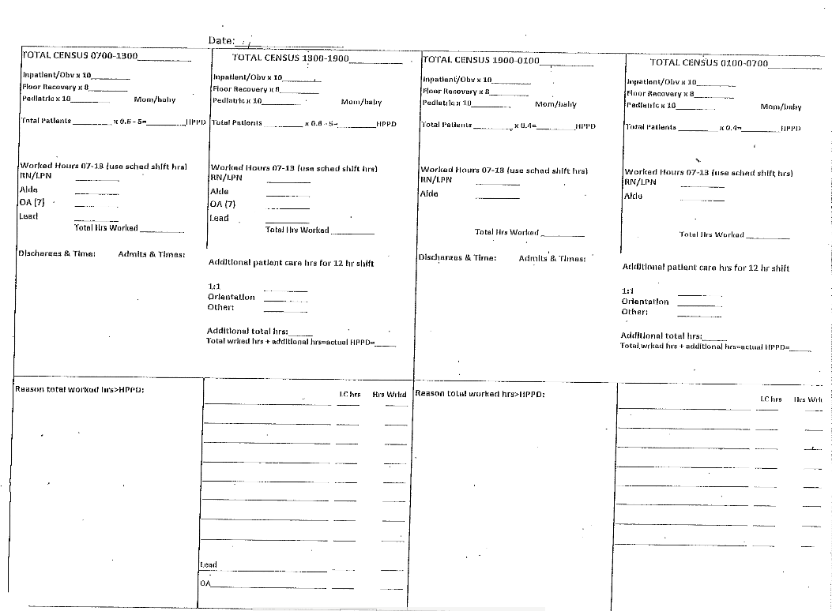
Current Staffing Worksheet
Notes:
Current tool
-utilizes old models of productivity and integrate nursing care hours to patient care hours to establish units staffing needs.
-Charge makes assignments based on subjective knowledge of patients conditions

Slide 6

Problem Statement
Depression
Stress
Anxiety
Burned Out!
Notes:
Globally and nationally COVID-19 has magnified many concerns that nurses have been expressing for years. We are just beginning to recognize the full impact of Covid-19 in the aftermath of 2020. This last year has caused nurses horrible stress, anxiety, and depression both at home and at work. With increased patients with acuity and high patient volumes we have started to see burnout.

Slide 7
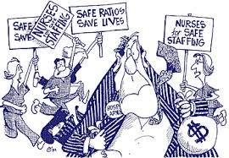
Significance of Clinical Problem
35% - moderate to severe trauma related distress
15% - moderate to severe depression
12% - anxiety
8% - insomnia
(Ruiz & Gibson, 2020)
Notes:
Recent survey by Ruiz & Gibson, 2020 found that 35% of healthcare providers report moderate to sever trauma related distress, 15% report moderate to severe depression, 12 percent report anxiety and 8 percent report insomnia.
Nurse stagging problems have existed for year the pandemic has just magnified them. The status quo for nurse staffing is no longer acceptable. Fortuneatly CHI has looked internally at the significance of their clinical problem to address these concerns by identifying gaps within their current staffing model this was the major catalyst for the present project.

Slide 8
PICOT Question
P
Population: Inpatient nurses on Medical and Surgical Unit
I
Implementation: Staffing based on acuity scale for nursing patient assignments
C
Comparison: Compared to staffing based on productivity
O
Outcome: Increasing nursing satisfaction and decrease staff turnover
T
Time: By the end of July 2021
Notes:
The success of a project depends largely on well-designed research or PICOT questions providing a project plan.
A well formulated, question should provide clarity, guide decisions, enhance the chance of finding a solution, and, inform study design, as well as help to anticipate needed resources, and clarify the thought process in developing the research plan.
Our PICO question is, “In the inpatient nursing unit (P) how effective is staffing based on an acuity scale for nursing patient assignments (I) compared to staffing based on productivity (C) on improving nursing satisfaction and decreasing staff turnover?”
The growth of our evidenced based project comes from an expansion of this question and the literature search surrounding it.

Slide 9


Purpose Statement
The of this project is to.....
Measure
Research
Implement
Decrease Nurse Turnover & Increase Nurse Satisfaction
Educate
Design
Notes:
The purpose of our project is to measure, educate, research, design, and implement a process that will decrease nurse turnover and increase nurse satisfaction.

Slide 10




Review of Literature
Notes:
Florence Nightingale was known to prioritize patients based on their needs and coded patients from lowest to highest acuity based on their condition. This sort of triage has become a tenant of the nursing profession, with nursing education being steeped in the teaching of nurses on patient prioritization, and yet the way nursing resources are allocated within many healthcare organizations fails to recognize this important tenant of the nursing profession.
As we began to review current literature it was found that professional organizations do understand the importance of equitable nurse to patient staffing rations: including the Joint Commission, the Institutes of Medicine, The Centers for Medicare and Medicaid, and numerous other professional nursing organizations,

Slide 11

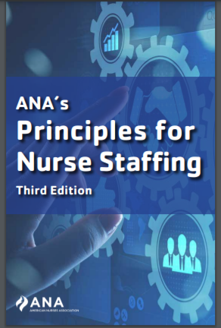
Released Staffing Guidance
Healthcare Consumer
Interprofessional Teams
Workplace Culture
Practice Environment
Evaluation
Notes:
Consumer
-what is the patient population, and how does staffing affect their care?
Interprofessional teams
-Staffing is an interprofessional problem, with all facets of the healthcare team having some input. However, nurses should have the biggest stake.
Workplace culture
-policies and procedures should facilitate nurse's ability to work to their full scope of practice,
-organization should facilitate a culture that values respect, trust, collaboration, and interprofessional teams .
Practice Environment
-nurses need to be provided the appropriate tools to perform their job. Evaluate shortcomings and how these shortcoming may impact staffing decisions and how these shortcomings may be remediated quickly
Evaluation
-continuous feedback
-nurses should feel empowered throughout the change process and leadership needs to open to nurses concerns and criticisms.

Slide 12
Changing Tide
1930’s
Staffing Matrix or Grid Model becomes standard
2003
California implements state mandate for patient staffing levels
2000
IOM publishes To Err is Human & Crossing the Quality Chasm
1965
Medicare is created
2012
Passage of the ACA
Healthcare is called upon to improve quality and dismantle fee-for-service payment structure
Notes:
External Evidence
In the 1930’s the staffing matrix or grid model were utilized and were based on industrial and manufacturing models. Manufacturing models utilized a time and motion method to determine the time needed for patient care tasks. This method created average times that nurses would need to complete theses tasks. The downfall is that nursing judgment and knowledge were not accounted.
A global pandemic and almost 100 years later organizations recognize the shortcomings of staffing matrixes and are working on appropriate staffing assignments. Legislation is also stepping up to regulate mandatory staffing rations.
In 2003, California implemented a state mandate for patient staffing levels and 14 states have since followed suite.

Slide 13
Making the Case
Nurses
Patients
Consistency
Equity
Satisfaction
Mortality
Falls
Pressure injury
Adverse Outcomes
Cost-effective
Kidd et al (2014), O’Keefe (2016)
Notes:
Kidd et al. (2014)
-clinically significant increase in nurses perception of the overall consistence and equitability of patient assignments as well as overall satisfaction with their workloads
-Nurses
Cost-effective
-O'Keeffe (2016) found decreased over time and nurses ability to complete task during their designated shift to their increase in productivity

Slide 14
Project Recommendations
ANA
Align staffing practice standards utilizing ANA’s staffing guidelines
Implement
Implement the chosen acuity scale with frontline staff
Evaluate
Key to success is encouraging feedback from front-line staff and allowing a continuous feedback loop
Notes:
ANA- there is no one size fits all approach which is routinely mentioned throughout ANA staffing guidance, so we would like to see our organization align closely with this guidance.
-Nursing students, and preceptees will not be considered as staff and will not be considered when it comes to implementation.
-We hope to work with leadership to outline which acuity tool will fit the needs of both the medical-surgical unit as well as the organizational needs .
-Encourage feedback from staff as well as ease of use during implementation stage.

Slide 15
Acuity Scale adapted from Kidd, M., Grove, K., Kaiser, M., Swooda, B., & Taylor A. (2014)
Notes:
“Acuity Scale adapted from Kidd, M., Grove, K., Kaiser, M., Swooda, B., & Taylor A. (2014)”

Slide 16
Project Timeline
April 6th
May 3rd
May 26th
June 1st
Mid-June
Met with clinical nurse committee.
Project was received well, and nurses were open to the project.
;
Met with ICU/ED staff to demonstrate the acuity tool.
High-interest in utilizing the tool from director and staff.
Preintervention surveys distributed.
Med-surg. meeting nurses were overall receptive.
Preintervention surveys distributed to the med-surge unit.
“It won’t change our patient load anyways.”
Check in with ICU
Go-live day for both ICU and Med-surg.
One question was raised regarding 1:1 suicide precautions.
Proposal of a clinical ladder involving the acuity tool.
All pre-interventions surveys collected and transcribed.
Med-surge and ICU check-ins
Charge and staff nurses report the acuity tool as useful sighting the visual aspect of the scale was useful.
No change to assignment volumes

Slide 17
Project Timeline
August 20th
August 4th
July 30th
July 19th
Feedback from night charge nurse, “tool would be more effective with higher census”
Some charges feel the tool is a burden, however the colors do help decided when placing admissions.
July 21st
Final organizational presentation with clinical and executive leadership.
Handoff plan goes into effect
ICU director shared that nursing report sheets are including a section for acuity.
Post-intervention surveys distributed.
Post-intervention surveys collected and transcribed for further evaluation of the project

Slide 18
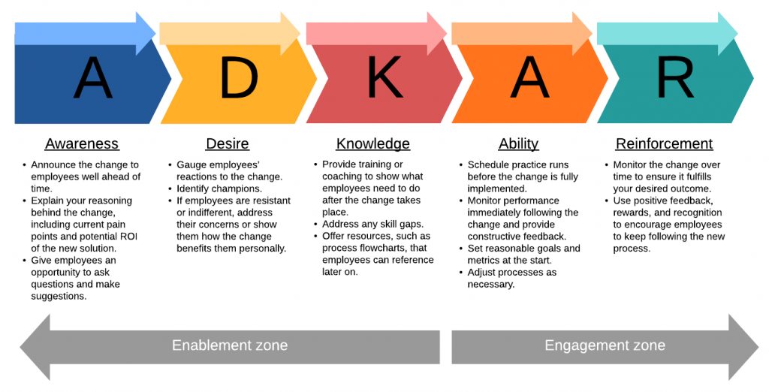
Implementation Plan: Change Theory
Retrieved from: https://sergiocaredda.eu/organisation/tools/models-the-adkar-change-management-model/

Slide 19
Key Stakeholders
Patients
Inpatient Nurses
Managers
CHI St. Alexius
Health
VP of Patient Care Services
Directors
Charge Nurses

Slide 20
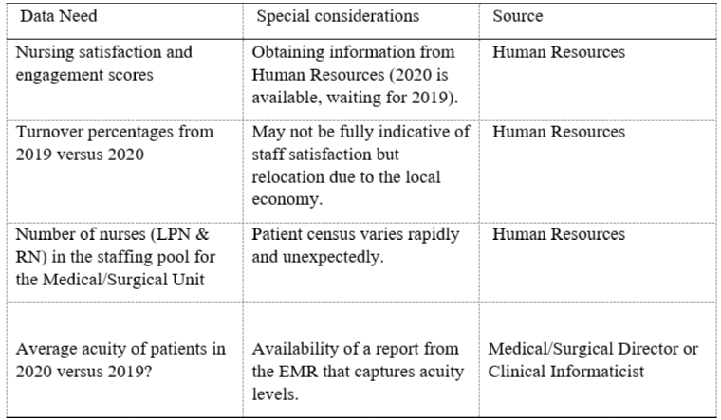
Measurement Plan
Notes:
-Metrics and how we intend to collect them.

Slide 22
Preintervention Survey Data
Twelve surveys in total collected
A blind approach was utilized
Mean scores demonstrated neutrality towards most survey questions.

Slide 23

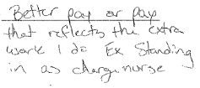




Preintervention Survey Comments
Notes:
-question should have been worded more specifically towards the project.

Slide 24
Postintervention Survey Data
Five surveys collected,
One question added to survey.
Overall satisfaction showed a decrease.

Slide 25




Postintervention Survey Comments

Slide 26
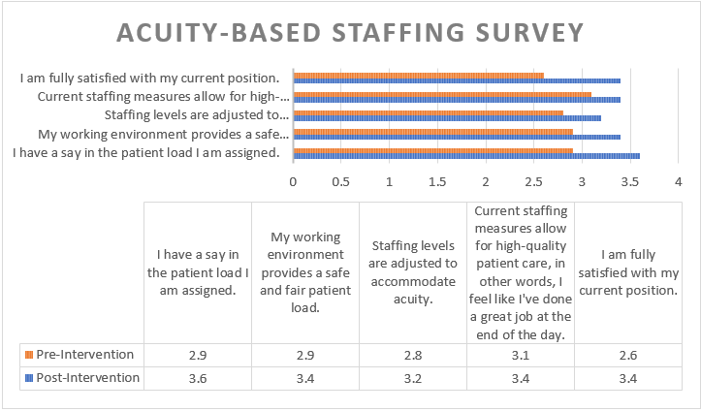

Slide 27
Project Measurement Plan
Data source – Nursing staff, nursing managers
Data collection – Employee Pulse Surveys, HCAHPS scores
Who will collect the data? Our team in collaboration with Human Resources, Inpatient Unit Charge Nurses, and the Director of the Inpatient Unit.
Data analysis - Review trends in patient outcomes along with staff turnover and retention rates.

Slide 28

Barriers and Drivers
Process Change
Leadership
Education
Notes:
Barriers
-Resistance to change given the current method has been in use for decades
-Time
-Turnover
-Willingness
Drivers
-Strong leadership
-interprofessional team
-Crisis instilling the need for change

Slide 29
Business Impact
Decrease Turnover
Increased Productivity
Cost Savings & Better Organizational Outcomes
Improved Patient Outcomes
Notes:
Turnover was high prior to pandemic
-costs $40,000-$64,000 to replace a clinical nurse on average hospitals spend between $4.4 to $6.9 million
O’Keefe (2013)
-demonstrate acuity-based staffing increases productivity indicating that organizations that implemented an appropriate acuity based staffing matrix saw patient's length of stay decrease by one day. This means organizations are optimizing their resources without placing undo strain on front-line staff
Patient Outcomes
-moving away from fee-for-service to quality-based reimbursement.

Slide 30
Organization Planning Process
Provide a foundation of integrity, compassion, and excellence
Implement
Support CHI’s core values
Generate support from leadership
Collaborate with front line staff
Feedback
Refine
We are here!
Notes:
1st ensure project is vested and aligns with CHI core mission, vision, and core values on the healing ministry of the church.
2nd this is how our project supports these values
3rd garner engagement and buy-in from leadership as all levels of the organization
4th generate input from frontline staff
^{5th} implementation
6th garner feedback
7th refine as appropriate

Slide 31
Implementation Action Plan
Initial Phase: Awareness
Phase 2: Desire
Phase 3: Knowledge
Phase 4: Recognition
Phase 5: Reinforcement
Notes:
Guided by Jeff Hiat's ADKAR Model for Change the team implemented change by following a phased approach. The initial phase includes awareness of a needed change by both leadership and staff. Once awareness is achieved then there must be a desire. The desire of staff to assist in the implementation will help both support and make the change successful. Staff often recognize that a change is necessary, but if they do not wish to create the change it will then be met with resistance and not be successful. The 3rd phase includes gaining knowledge by completing a literature review and synthesis of both internal and external data. Education also needs to be presented to nursing staff both formally and informally to help with successful implementation. Moving forward with the project the team will work on recognition of the current models compared to the acuity-based staffing models and create a plan to be trialed. The 5th and final phase will be reinforcement and support of the project to achieve sustainability.

Slide 32

Hand off Plan
The acuity tool process has been in place since the end of May, 2021. Hand off occurred end of July, 2021.
Color codes are actively placed on the assignment board on med/surg every shift and on the report form in ICU.
Charge nurses on the medical/surgical unit will access the tool when necessary and will continue with color codes if desired.
ICU nurses will utilize the tool when/if patient volumes and/or acuity increases.
Department Directors and Lead RNs are supportive of the tool and its use whenever applicable.

Slide 33



Human Subject Protection Statement
IRB Submission
Status: Full Approval!
Notes:
After project development and IRB was completed and will be submitted to both University of Mary board and CHI for approval to ensure the EBP is performed to meet ethical and professional standards.
The goal is to obtain an IRB "exempt" status which will ensure there are no risks to participants, precautions are taken to ensure participant safety and protect their privacy and confidentially, along with ensuring participatisn rights and welfare are protected throughout implementation.
Upate will be provided when IRB is reviewed by both University of Mary and CHI IRB review committee.

Slide 34
Conclusion
Inconclusive survey data
Covid-19 has magnified staffing issues
Questions?
Notes:
The current staffing problems magnified by Covid-19 are not new issues, nurses have been ringing the fire alarms on these staffing inequities for decades and finally the literate is catching up with them.
And feel strongly that acuity-based staffing is an evidence-based method to increase nursing satisfaction and decrease nursing sensitive qulatiy indicators
Now is the time to implement a staffing model that reflects nursing knowledge, time, and effort.

Slide 35
References
American Nurses Association. (2019). ANA's Principles for Nurse Staffing. Silver Spring: American Nurses Association.
Chiulli, K. A., Thompson, J., & Requin-Hartman, K. L. (2014). Development and Implementation of A Patient Acuity Tool For a Medical-Surgical Unit. Academy of Medical-Surgical Nurses, 9-12.
Glasper, A. (2020). Helping nurses to provide optimum care in the second wave of the pandemic. British Journal of Nursing, 29(21), 1292-1293. https://doi.org/10.12968/bjon.2020.29.21.1292
Hertel, R. (2012). Regulating Patient Staffing: A Complex Issue. Med-Surg Matters, 21(1), 3-7.
Hiatt, J. M. (2006). ADKAR: A model for change in business, government, and our community.Loveland: Prosci Learning Center Publications.

Slide 36
Hill, B. (2020). Changes to nurse-to-patient ratios in intensive care during the pandemic. British Journal of Nursing, 29(21), 1238–1240. https://doi.org/10.12968/bjon.2020.29.21.1238
Hinton, L., Gaisie, N. E., Schnake, K. L., & Zoubak, E. (2020). Cultivating Adaptive Leaders to Drive System and Policy Change. ZERO TO THREE, 40(5), 12–19.
Ingram, A., & Powell, J. (2018). Patient acuity tool on a medical-surgical unit. American Nurse, 1-7. Retrieved from https://www.myamericannurse.com/patient-acuity-medical-surgical-unit/
Kidd, M., Grove, K., Kaiser, M., Swooda, B., & Taylor, A. (2014). A new patient- acuity tool promotes equitable nurse- patient assignments. American Nurse Today, 9(3), 1-4.
Labrague, L. J., McEnroe, P. D., D’Souza, M. S., Cecily, H. S. J., Fronda, D. C., Edet, O. B.,
Ibebuike, J. E., Venkatesan, L., Almazan, J. U., Al Amri, M., Mirafuentes, E. C., Cayaban, A. R. R., Al Yahyaei, A., & Bin Jumah, J. A. (2019). A Multicountry Study on Nursing Students’ Self‐Perceived Competence and Barriers to Evidence‐Based Practice. Worldviews on Evidence-Based Nursing, 16(3), 236–246. https://doi- org.ezproxy.umary.edu/10.1111/wvn.12364

Slide 37
Malloch, K. (2012). Changing Tides: Increasing Evidence to Embrace a Patient Classification System. Nursing Economics, 30(6), 356-358.
McHugh, M. D., Kutney-Lee, A., Cimiotti, J. P., Sloane, D. M., & Aiken, L. H. (2011). Nurses' widespread job dissatisfaction, burnout, and frustration with health benefits signal problems for patient care. Health affairs (Project Hope), 30(2), 202–210. https://doi.org/10.1377/hlthaff.2010.0100
Melnyk, B. M., & Fineout-Overholt, E. (2019). Evidence-based practice in nursing and healthcare (4th ed.). Wolters Kluwer.
NSI Nursing Solutions. (2019). 2020 NSI National Health Care Retention & RN Staffing Report (Rep.). NSI Nursing Solutions.

Slide 38
O'Keeffe, M. (2016). Practical steps for applying acuity-based staffing. American Nurse Today, 11(9), 30-34.
Pintanela de Carvalho, D., Pereira Rocha, L., de Pinho, E. C., Tomaschewski-Barlem, J. G.,
Devos Barlem, E. L., & Salomão Goulart, L. (2019). Workloads and burnout of nursing workers. Revista Brasileira de Enfermagem, 72(6), 1435–1441. https://doi.org.ezproxy.umary.edu/10.1590/0034-7167-2017-0659
Ruiz, M. A., & Gibson, C.-A. M. (2020). Emotional impact of the covid-19 pandemic on US health care workers: A gathering storm. Psychological Trauma: Theory, Research, Practice, and Policy, 12(S1), S153–S155. https://doi.org/10.1037/tra0000851
Trepanier, S., Lee, D. W., & Kerfoot, K. M. (2017). Interoperable Acuity-Based Staffing Solutions: Lessons Learned From a Multi-Hospital System. Nursing Economics, 35(4), 184-204.

Slide 39
Vortherm, J., Spoden, B., & Wlcken, J. (2015). From Evidence to Practice: Developing an Outpatient Acuity-Based Staffing Model. Clinical Journal of Oncology, 19(3), 332- 337.
Weston, M. J., Brewer, K. C., & Peterson, C. A. (2012). ANA Principles: The Framework For Nurse Staffing to Positively Impact Outcomes. Nursing Economic$, 30(5), 247– 252.
Wilson, M., Guta, A., Waddell, K., Lavis, J., Reid, R., & Evans, C. (2020). The impacts of
accountable care organizations on patient experience, health outcomes and costs: a rapid review. Journal of Health Services Research & Policy, 25(2), 130–138. https://doi-org.ezproxy.umary.edu/10.1177/1355819620913141

